Slide 1
Homwork 02
Yuerong Wu

Slide 2
AI Finance Assignment Completion List
Course: MB/CSE 599 — AI Finance
GitHub Username: yuerongwu-dev
Network: Base Sepolia Testnet
Part 0 — GitHub Setup
Created and configured my GitHub account.
Followed the instructor's GitHub account, aaron-recompile.
Starred the instructor's AI_Finance repository.
Prepared a GitHub screenshot showing my username and repository status.
Part 1 — DeFi Experiments
Experiment 1: Token Swap (SWAP)
Installed and configured the MetaMask wallet.
Connected MetaMask to the Base Sepolia test network.
Minted free MAX and tUSDC test tokens.
Explored token swapping, exchange rates, and price impact.
Approved MAX token spending for the swap contract.
Completed the GitHub Pull Request submission process for the bonus assignment.

Slide 3
AI Finance Assignment Completion List
Experiment 2: Liquidity Farming (FARM)
Explored the MAX/tUSDC liquidity pool.
Learned how liquidity provision generates LP tokens.
Reviewed the LP staking, reward harvesting, and withdrawal functions.
Experiment 3: Flash Loan Arbitrage
Connected MetaMask to the Flash Loan Arbitrage application.
Compared token prices across two decentralized exchanges.
Analyzed borrowing amounts, repayment obligations, transaction fees, and estimated profits.
Used the Optimal Amount calculator to evaluate arbitrage profitability.
Identified that the 0.65% price difference was insufficient to cover the combined fees and price impact.
Documented the negative estimated profit and explained why the transaction would revert.

Slide 4
AI Finance Assignment Completion List
Part 2 — Bonus: Pay Yourself
Forked the instructor's AI_Finance repository into my GitHub account.
Located week-03/code/flashloan-foundry/src/Arbitrageur.sol.
Modified the Solidity contract to transfer remaining USDC to msg.sender instead of owner.
Updated the code comment to reflect the new profit recipient.
Committed the changes to my forked repository.
Completed the GitHub Pull Request submission process for the bonus assignment.
Summary
This assignment provided hands-on experience with GitHub, MetaMask, decentralized finance applications, token swapping, liquidity farming concepts, flash-loan arbitrage analysis, and Solidity smart contract modification.
GitHub Repository: https://github.com/yuerongwu-dev/AI_Finance

Slide 5
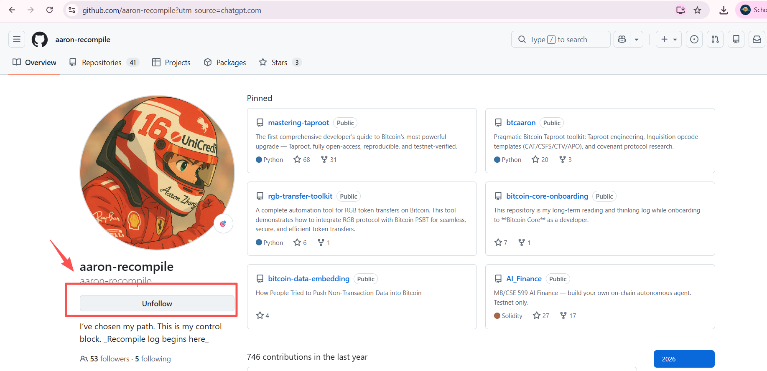
Github
PART 0 — Get on GitHub (required)
Every developer lives on GitHub, and you'll need an account for the Bonus anyway.
1) Create a free account at github.com/signup (skip if you have one).
2) Follow the course account: github.com/aaron-recompile → Follow.
3) Star the course repo: github.com/aaron-recompile/AI_Finance → Star (top-right).
Screenshot: the repo page with the star filled (it shows "Unstar") and YOUR username visible top-right.

Slide 6
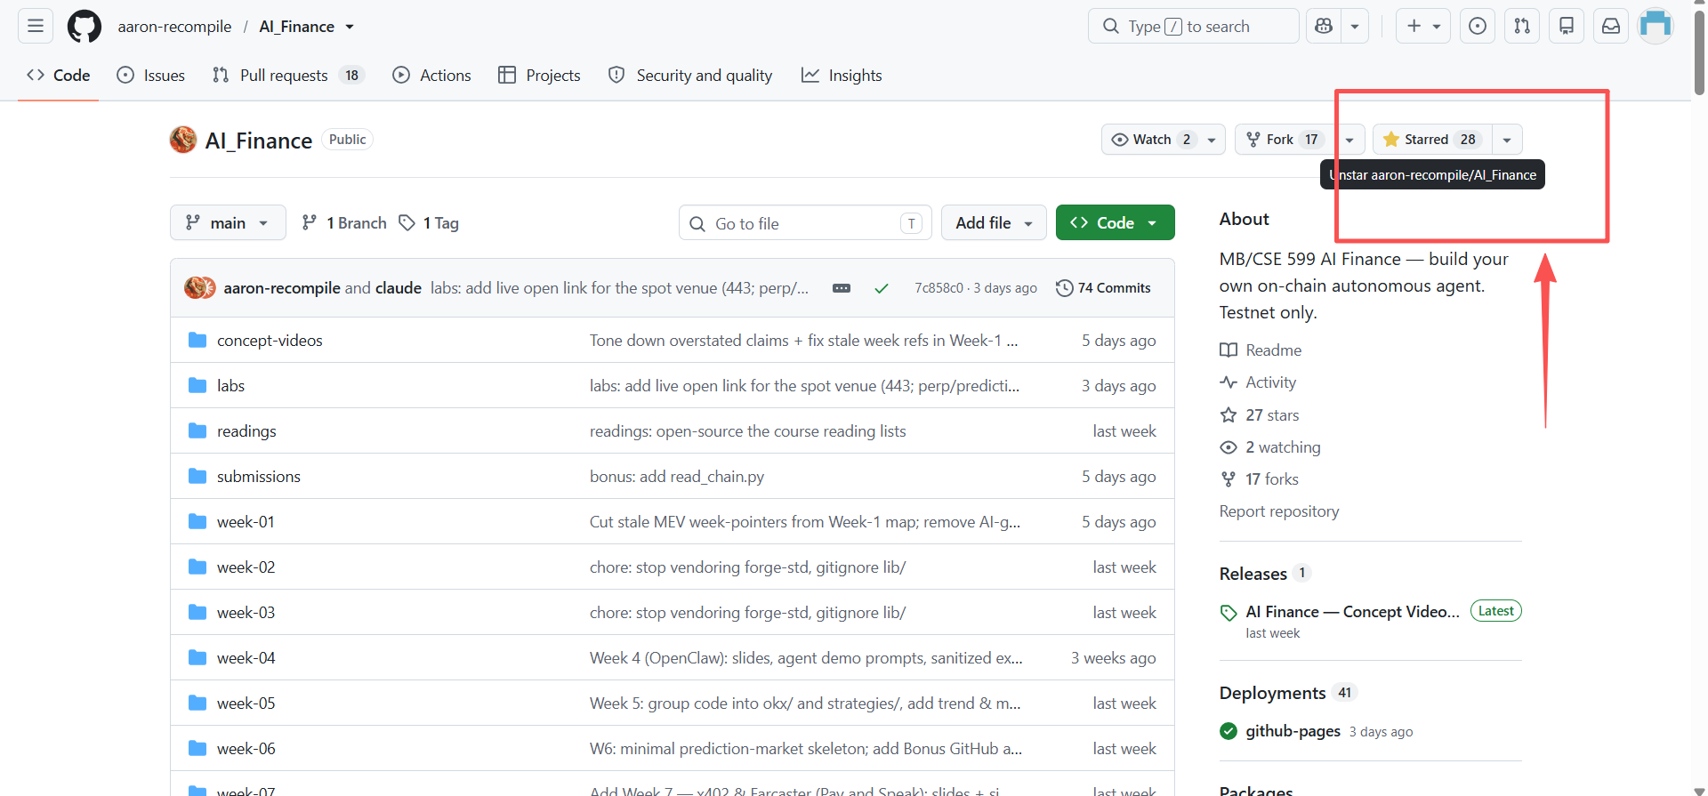
Github
3) Star the course repo: github.com/aaron-recompile/AI_Finance → Star (top-right).
Screenshot: the repo page with the star filled (it shows "Unstar") and YOUR username visible top-right.

Slide 7
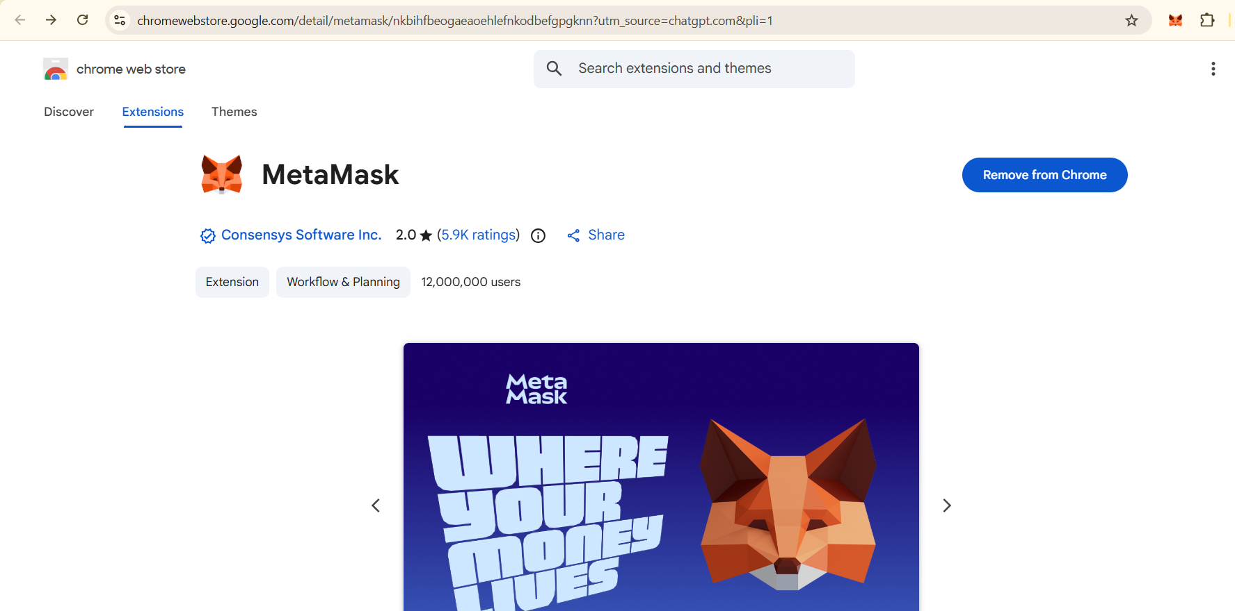
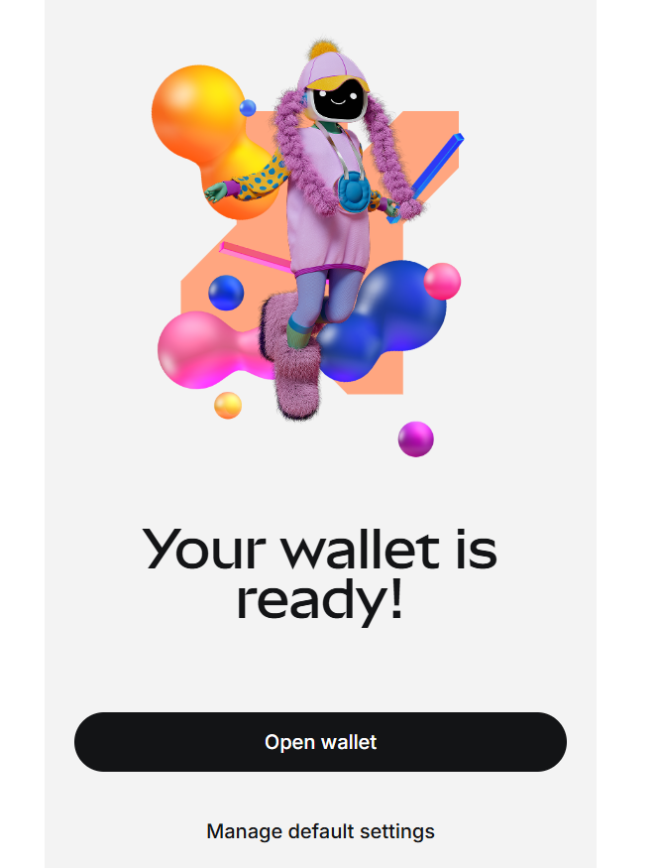
Part 1 — DeFi
✅️ Add MetaMask in Chrome
✅️ Create new wallet

Slide 8
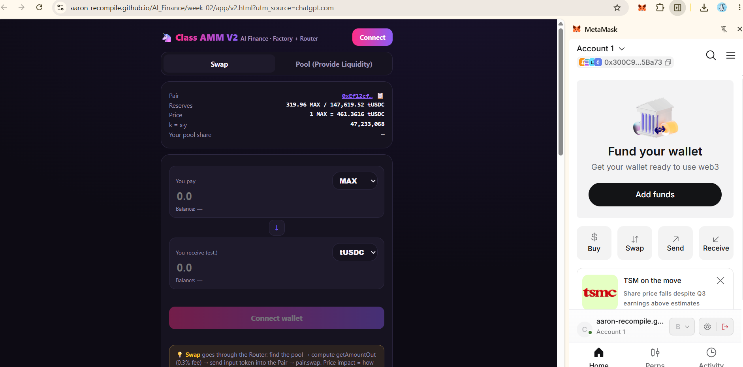
Part 1 — DeFi
✅️ Connect wallet

Slide 9
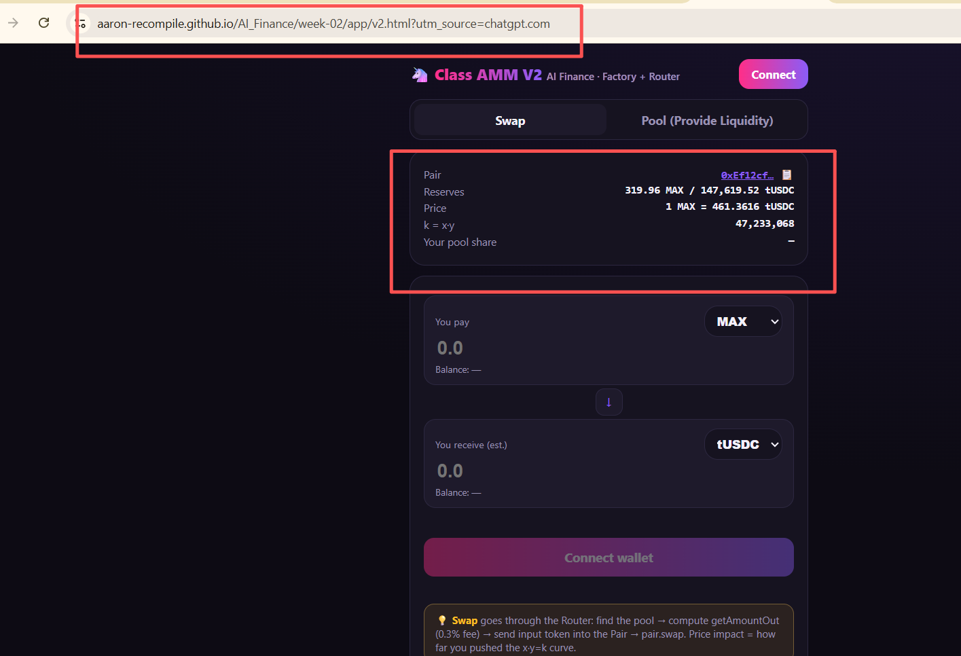
Part 1 — DeFi
Part 1 — DeFi
✅️ connect to SWAP

Slide 10
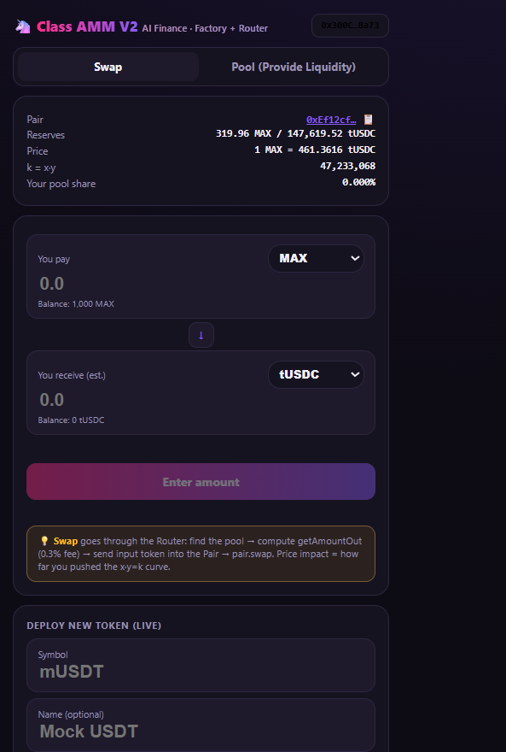
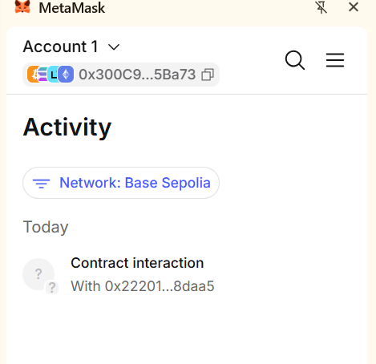
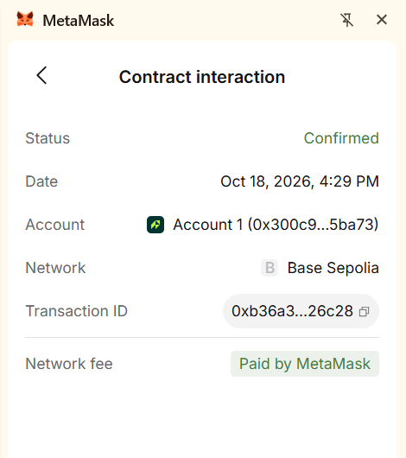
Part 1 — DeFi
✅️ get test token ： 1,000 MAX

Slide 11
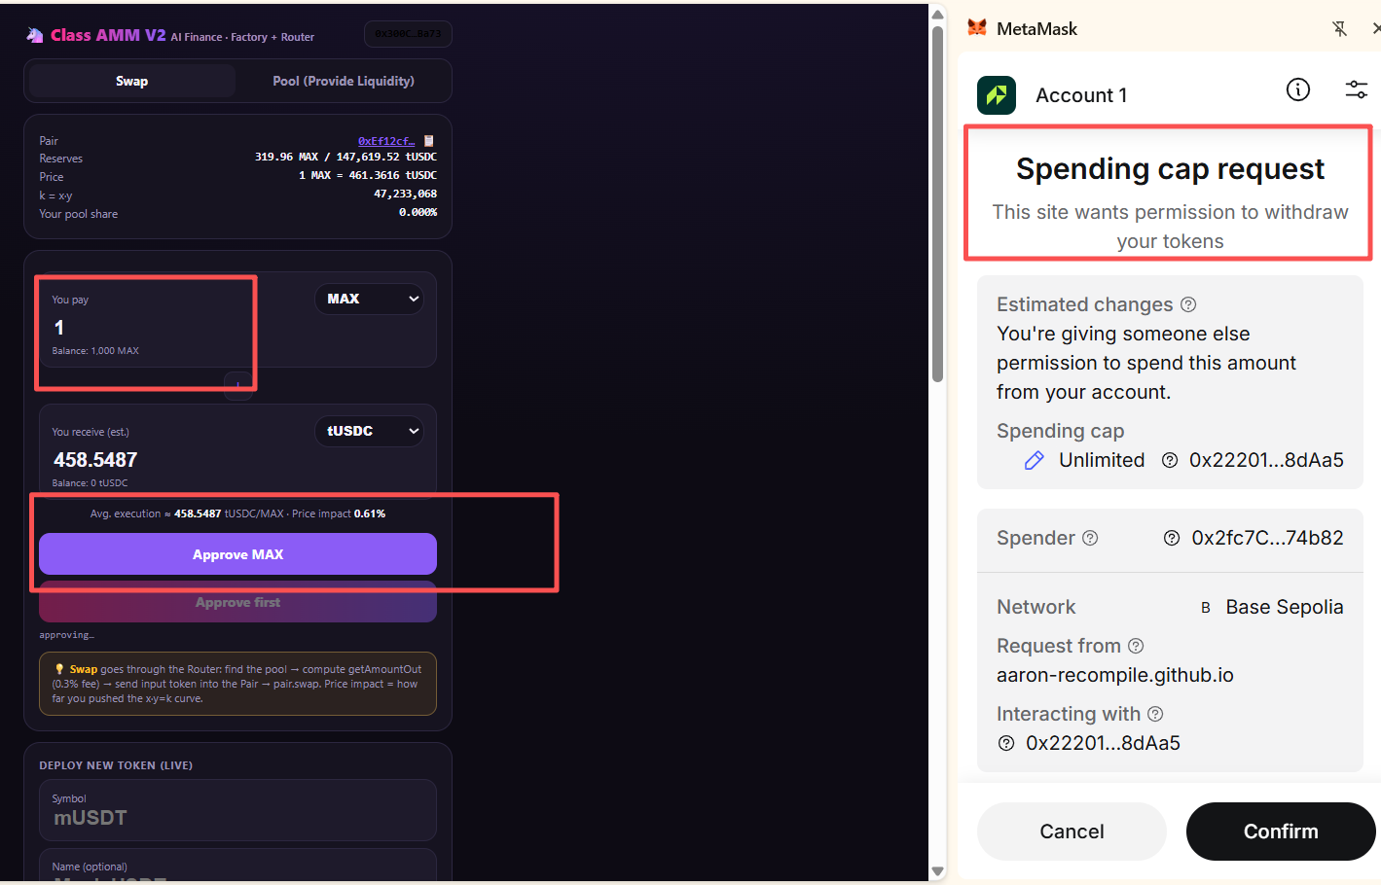
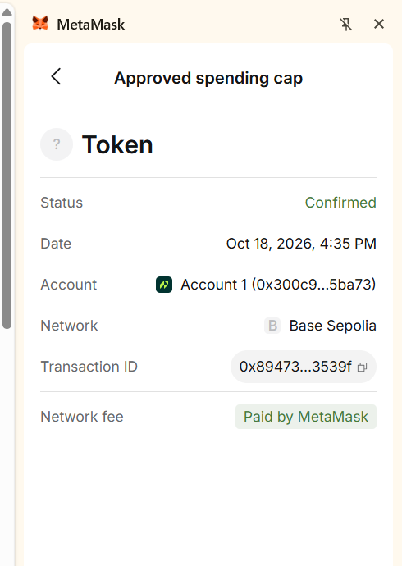
Part 1 — DeFi
✅️ make payment

Slide 12
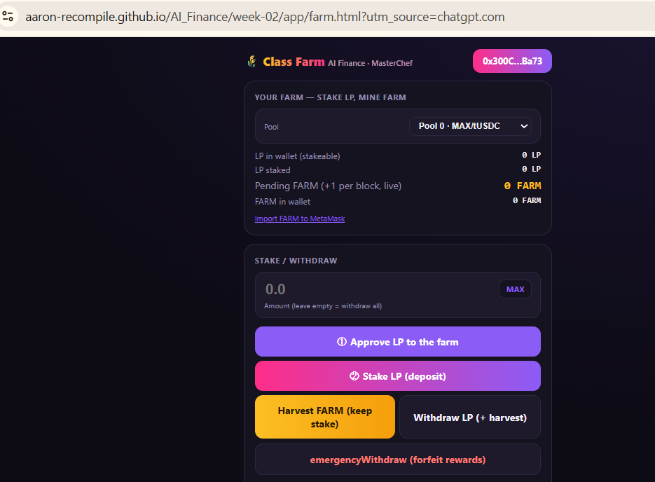
Part 1 — Experiment 2: FARM
✅️
Connect FARM

Slide 13
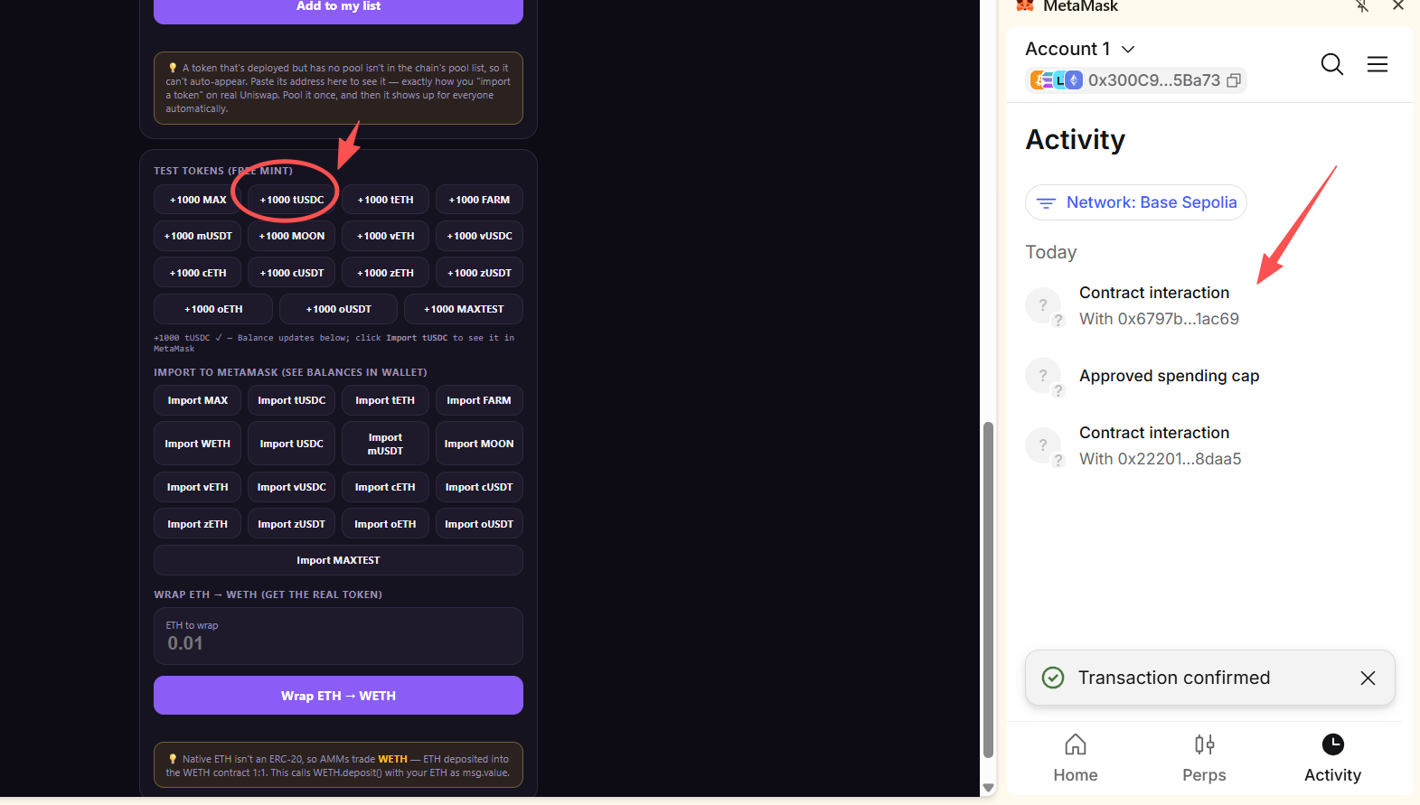
Part 1 — Experiment 2: FARM
✅️
Get 1000 tUSDC

Slide 14
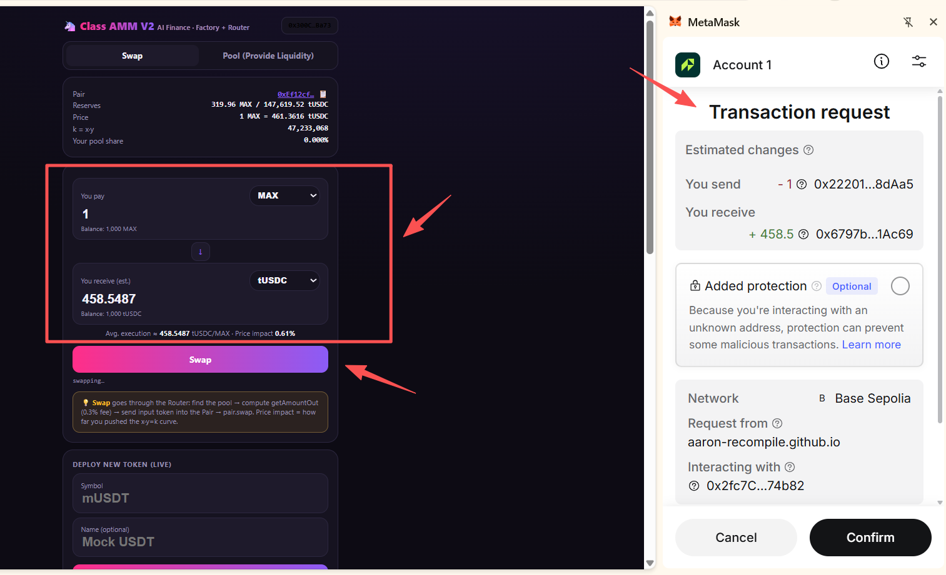
Part 1 — Experiment 2: FARM
✅️
Make payment

Slide 15
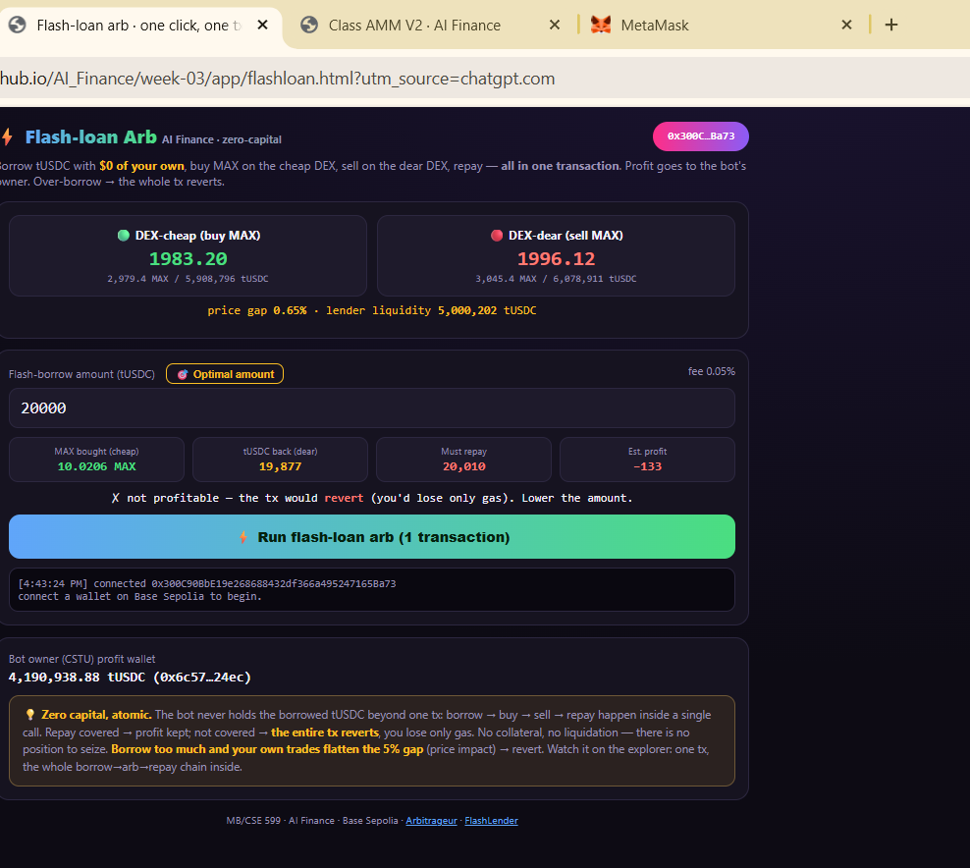
Experiment 3 — FLASH LOAN
✅️
connect

Slide 16
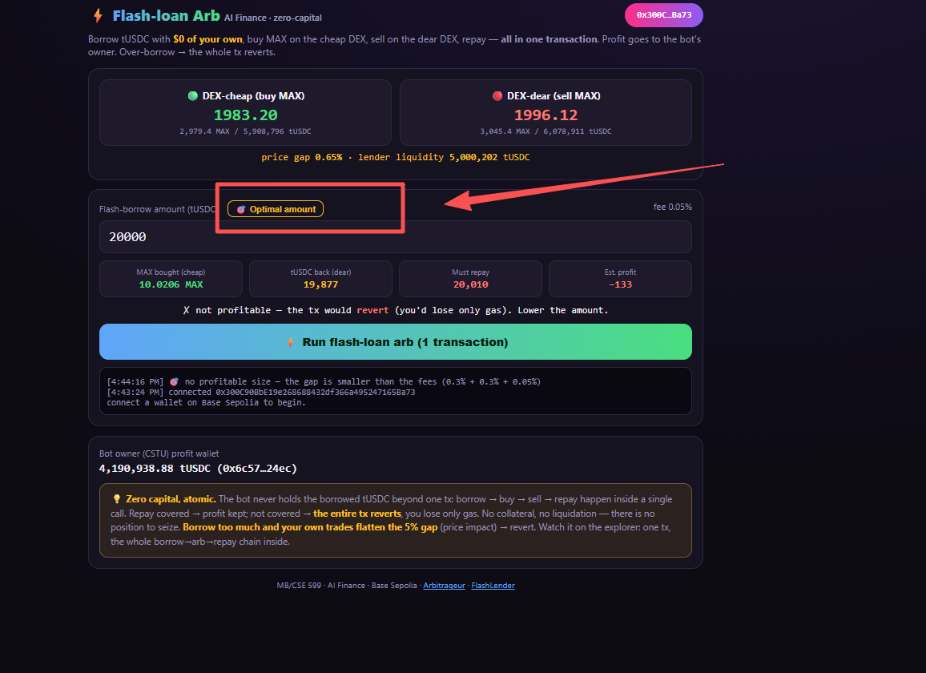
Experiment 3 — FLASH LOAN
Optional Amount

Slide 17
Experiment 3 — FLASH LOAN
Flash Loan Arbitrage – Experiment Result
I connected my MetaMask wallet to the Base Sepolia test network and analyzed a flash-loan arbitrage opportunity between two decentralized exchanges.
The observed price gap was approximately 0.65%, while the combined trading and flash-loan fees were also 0.65%.
With a simulated borrowing amount of 20,000 tUSDC, the estimated profit was -133 tUSDC. The Optimal Amount tool confirmed that no profitable borrowing size was available under the current market conditions.
This experiment demonstrated that price differences alone do not guarantee arbitrage profits. Transaction fees, price impact, and liquidity constraints must also be considered.

Slide 18
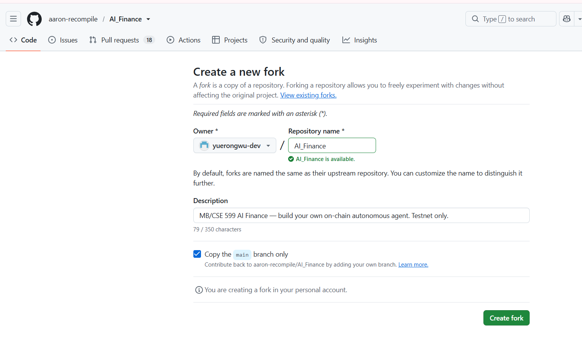
PART 02 - Bonus: Pay Yourself

Slide 19
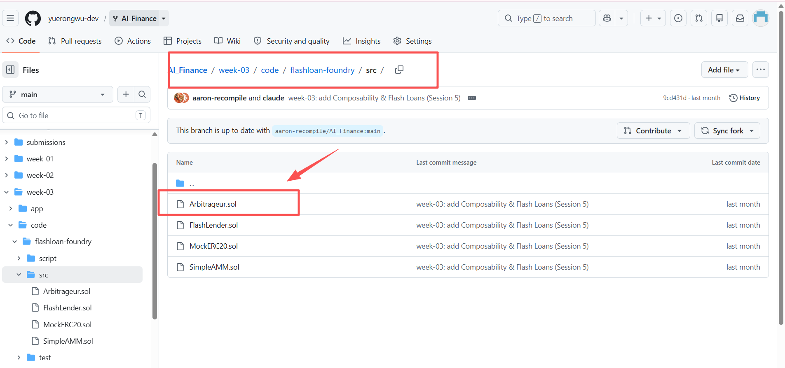
PART 02 - Bonus: Pay Yourself

Slide 20
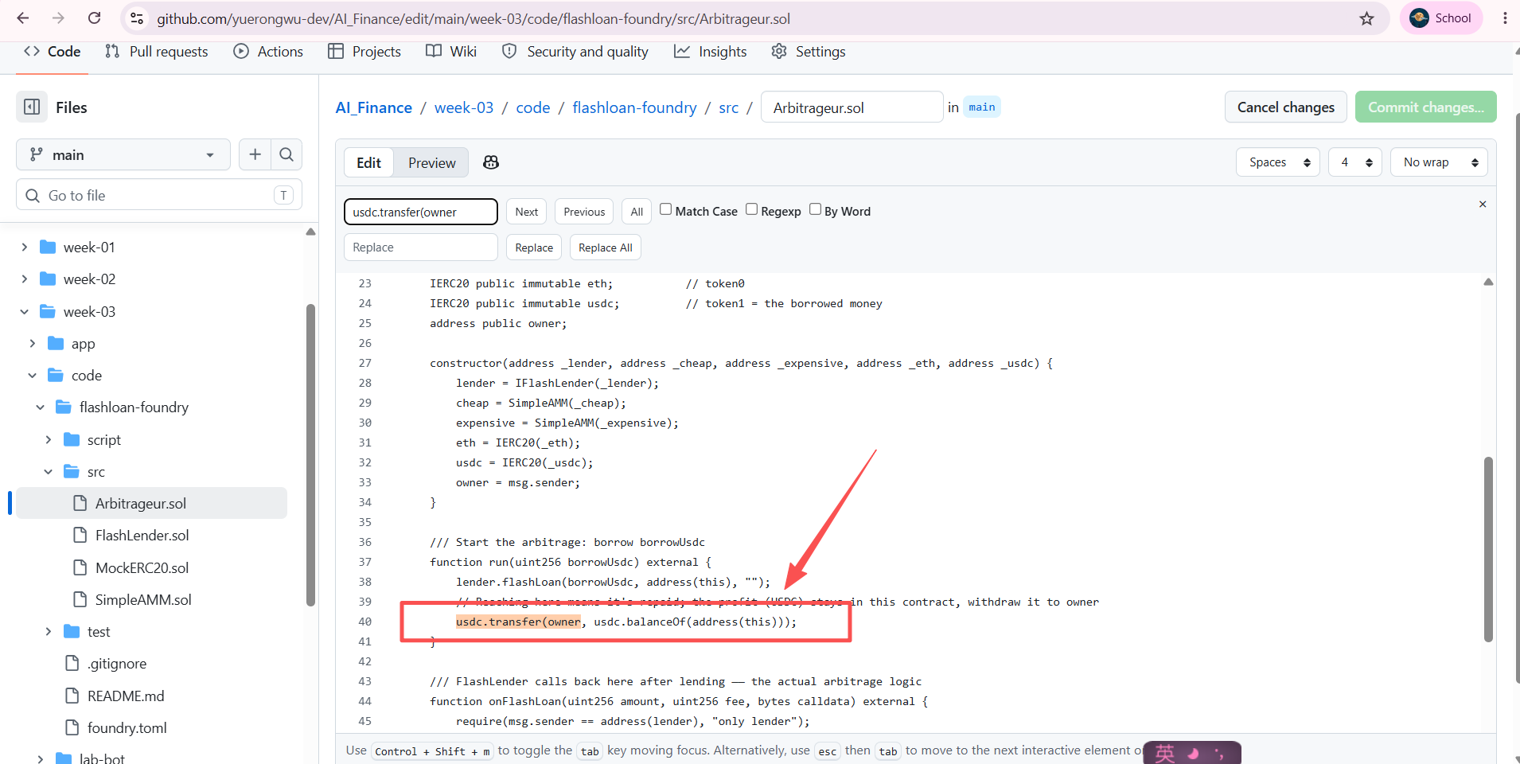
PART 02 - Bonus: Pay Yourself

Slide 21
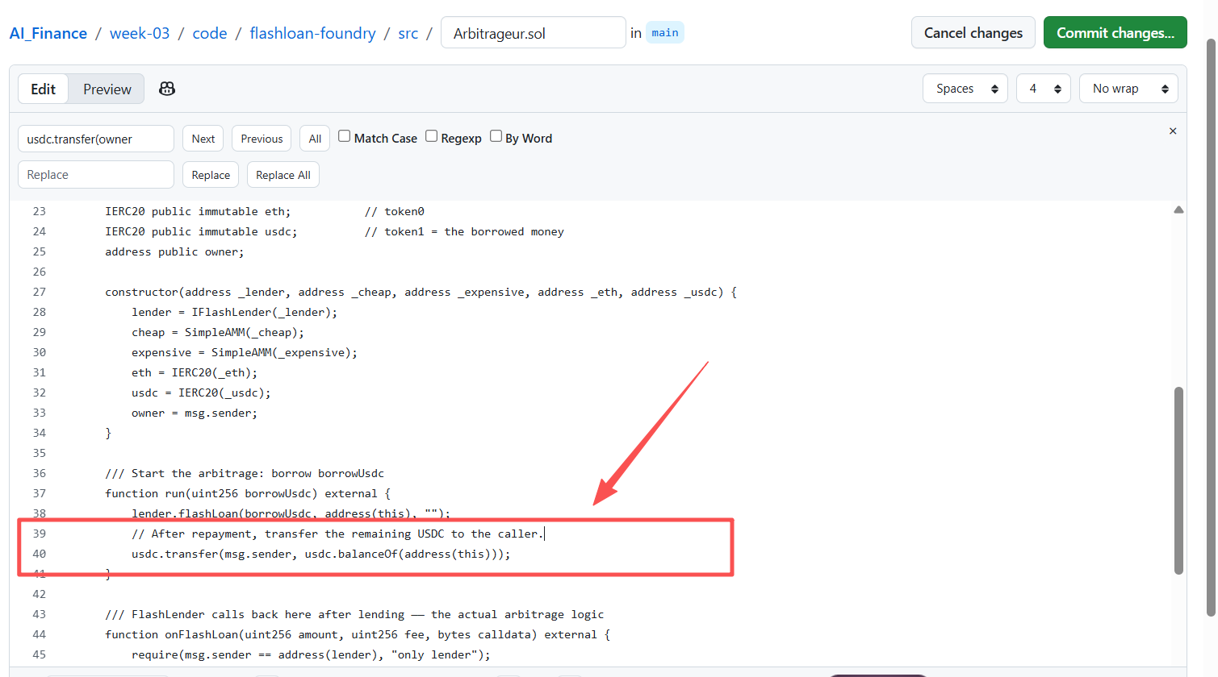
PART 02 - Bonus: Pay Yourself

Slide 22
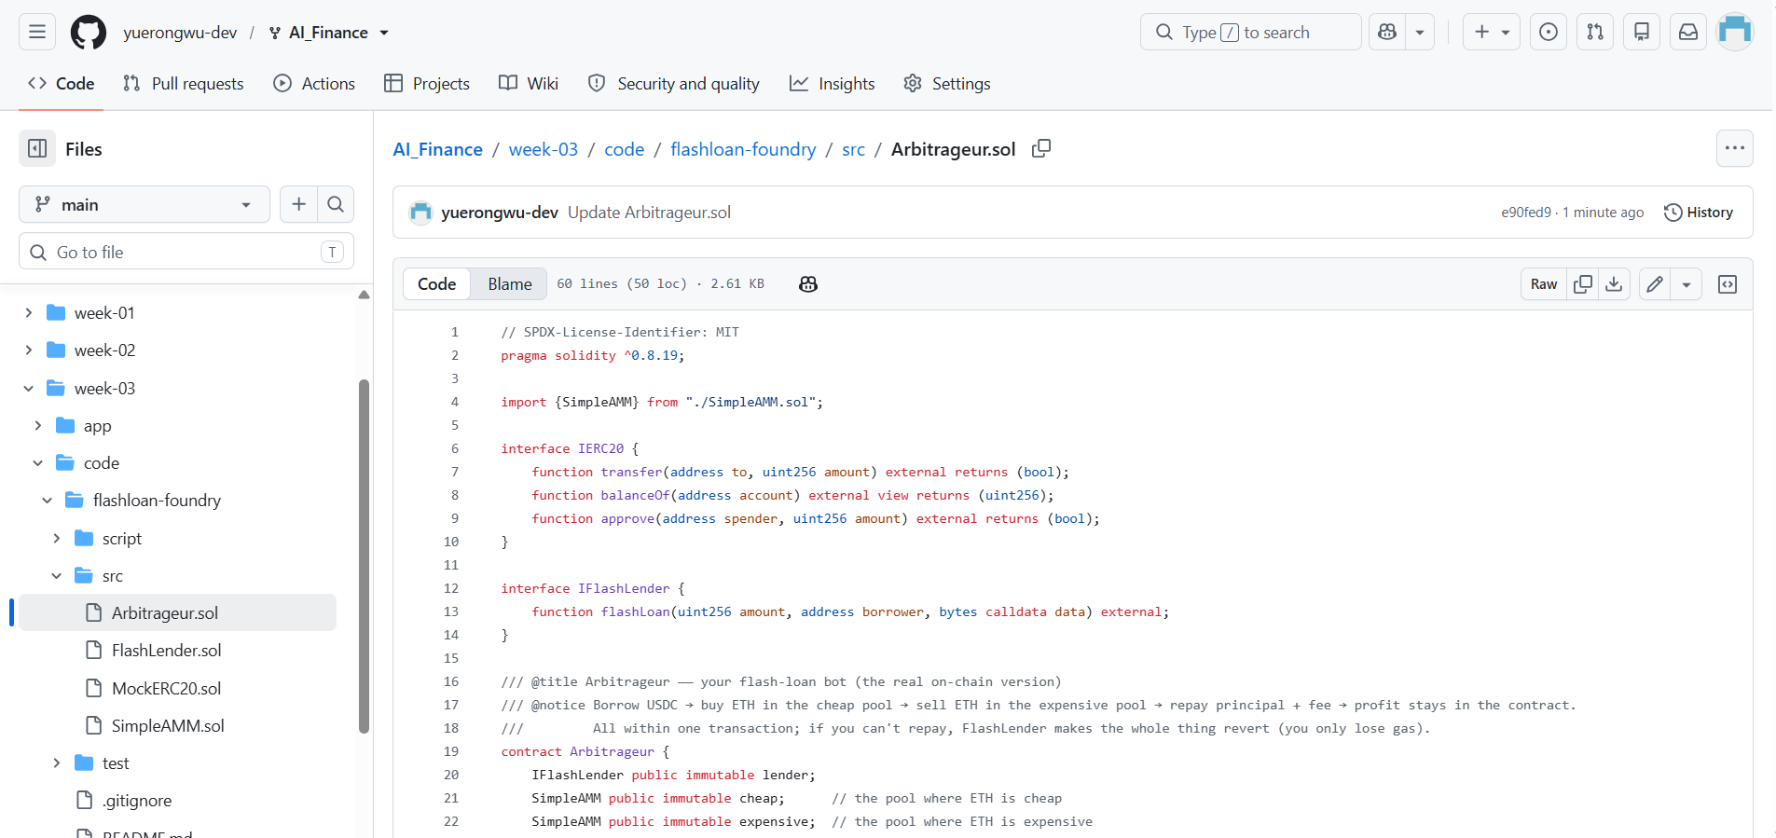
PART 02 - Bonus: Pay Yourself

Slide 23
PART 02 - Bonus: Pay Yourself
Bonus: Pay Yourself
Updated Arbitrageur.sol to transfer the remaining USDC to msg.sender instead of the contract owner.
This change allows the caller of the run() function to receive the arbitrage profit.
I also updated the corresponding code comment for clarity.

